Slide 1
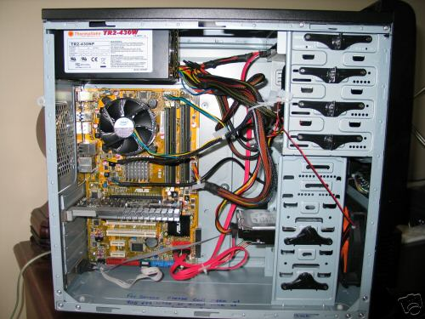
Optical Disk Drive
Power supply
Cooling fan
Motherboard
Ethernet Port
Audio Ports
Monitor port
Hard disk drive
USB expansion ports

Slide 2
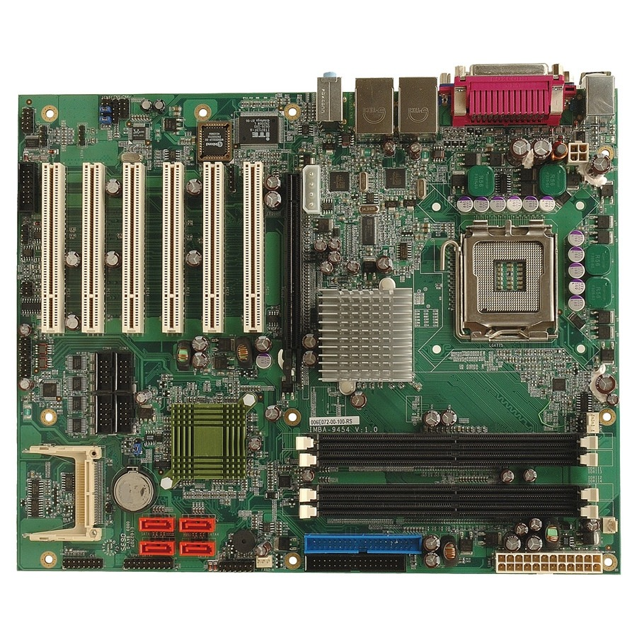
Wifi/Ethernet Network Reference
GPU
Sound Processor
CPU
CPU fan
RAM memory
SATA (Disk drive interface)

Slide 3
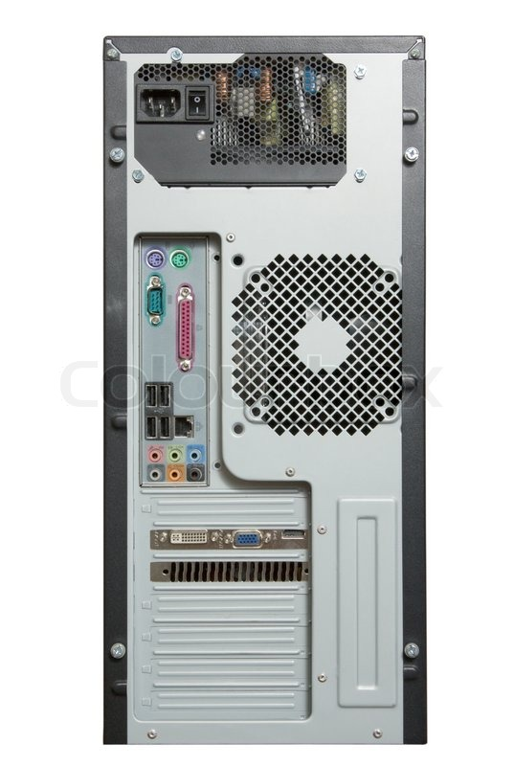
Power cord
Power switch
Keyboard interface
Mouse interface
USB ports
Cooling fan
Ethernet interface
Audio inputs/outputs
Monitor interface

